Slide 1

Customer Shopping Behavior Analysis
Analyzing 3,900 purchases to uncover insights into spending patterns, customer segments, and product preferences that drive strategic business decisions.

Slide 2
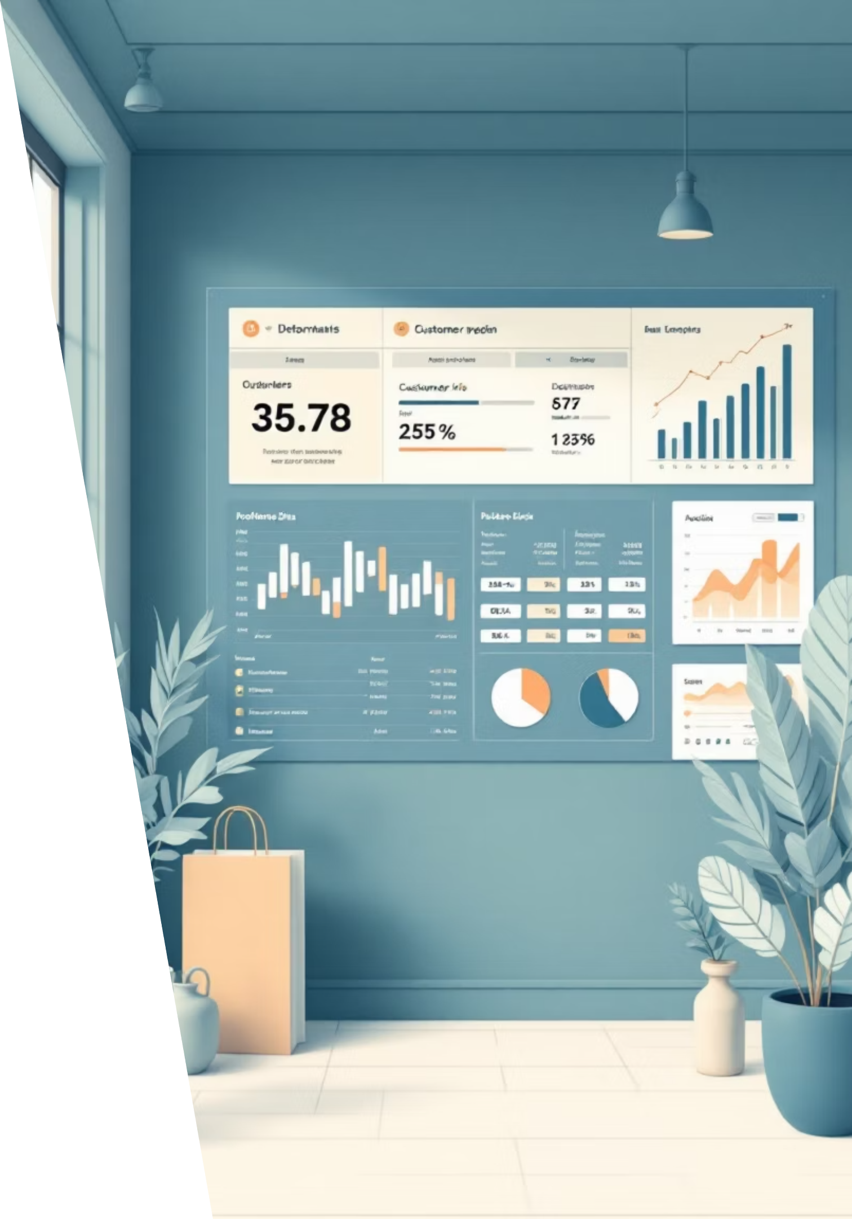
Dataset Overview
Scale
3,900 transactions across 18 data columns
Demographics
Age, gender, location, and subscription status tracked
Purchase Data
Item details, category, amount, season, size, and color
Behavior Metrics
Discounts, promo codes, purchase frequency, ratings, and shipping

Slide 3
Data Preparation Process
01
02
Data Loading & Exploration
Missing Data Handling
Imported dataset using pandas, analyzed structure with df.info() and summary statistics
Imputed 37 missing Review Rating values using median rating per product category
03
04
Feature Engineering
Database Integration
Created age_group bins and purchase_frequency_days columns for deeper analysis
Connected to PostgreSQL and loaded cleaned data for SQL business analysis

Slide 4
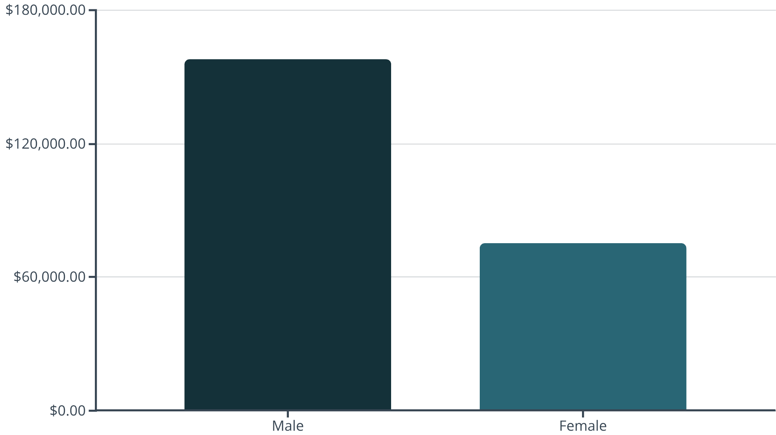
Revenue by Gender
Male customers generated $157,890 in total revenue, more than double the $75,191 from female customers.
This significant gap suggests opportunities for targeted marketing to increase female customer engagement and spending.

Slide 5

Customer Segmentation Insights
3,116
701
83
Loyal Customers
Returning Buyers
New Customers
The majority segment with consistent purchase history
Customers making repeat purchases
First-time purchasers entering the funnel
With 80% of customers classified as loyal, focus should shift to converting new and returning buyers into the loyal segment through targeted retention strategies.

Slide 6

Top-Rated Products
1
2
3
Gloves
Sandals
Boots
Average rating: 3.86
Average rating: 3.84
Average rating: 3.82
4
5
Hat
Skirt
Average rating: 3.80
Average rating: 3.78

Slide 7
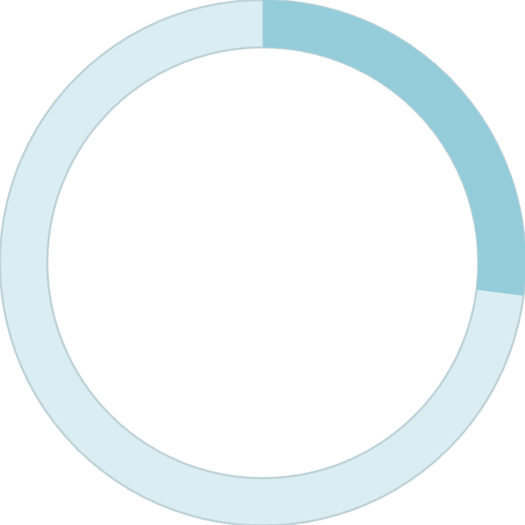

Subscription Analysis
27%
Subscription Rate
1,053 of 3,900 customers subscribed
Subscribers average $59.49 per purchase versus $59.87 for non-subscribers—minimal difference in spending behavior.
Among repeat buyers with 5+ purchases, 958 are subscribers while 2,518 are not, indicating significant untapped subscription potential.

Slide 8




Discount & Shipping Patterns
High-Value Discount Users
Express Shipping Premium
Discount-Dependent Products
839 customers used discounts but still spent above the $59.76 average purchase amount
Express shipping customers spend $60.48 on average versus $58.46 for standard shipping
Hats lead at 50% discount rate, followed by Sneakers at 49.66%

Slide 9
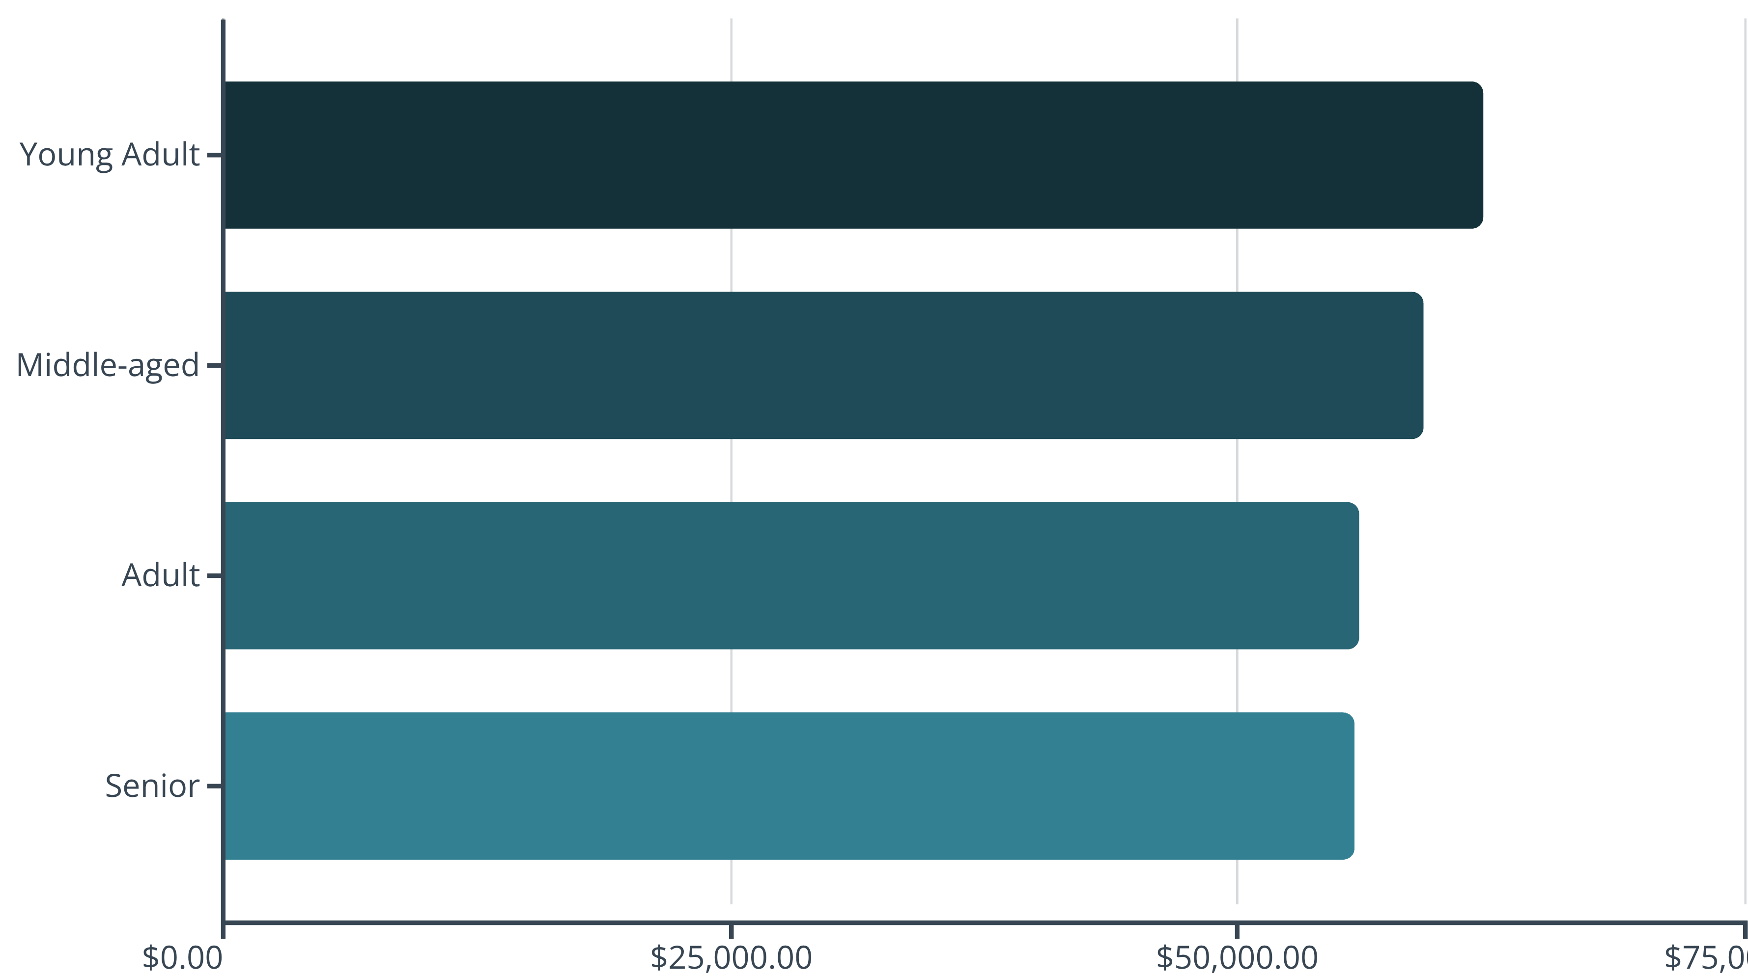
Revenue by Age Group
Young adults contribute the highest revenue at $62,143, with relatively balanced contributions across all age segments. Marketing efforts should maintain broad appeal while optimizing for the young adult demographic.

Slide 10





Strategic Recommendations
Boost Subscriptions
Promote exclusive benefits to convert the 2,518 repeat buyers who haven't subscribed
Customer Loyalty Programs
Reward repeat buyers to accelerate movement into the loyal segment
Optimize Discount Strategy
Balance promotional sales with margin control, especially for discount-dependent products
Targeted Marketing
Focus on high-revenue demographics and highlight top-rated products in campaigns

